Slide 1
Namma Yatri data analysis -Data-Driven insight & strategic recommendations
Business perspective
Gopika Rajkumar
Haripriya althi
Divyanshu Shekhar

Slide 2
Introduction
Namma Yatri is a Direct-to-Driver open mobility platform, developed by Juspay, powering the next-generation of mobility applications in India.app that has become Bengaluru's most loved auto app, since its formal launch in January 2023.

Slide 3
Executive Summary
Project Overview:
Analysis of Namma Yatri data to derive actionable insights.
Focus on improving operational efficiency and marketing strategies.
Data-driven recommendations for business growth.
Key Objective: Understand user behavior, ride performance, and revenue drivers
Tools: Power BI, Data Modelling, Visualization
Outcome: Actionable insights and strategy suggestions.

Slide 4
Business Context & Problem Statement
Rising ride demand but inconsistent performance
Need for data-backed operational and marketing insights

Slide 5
Data Integration and Cleaning
Imported and joined multiple tables in Tableau/Power BI.
Ensured data accuracy by resolving inconsistencies.
Created calculated fields for relevant analysis

Slide 6
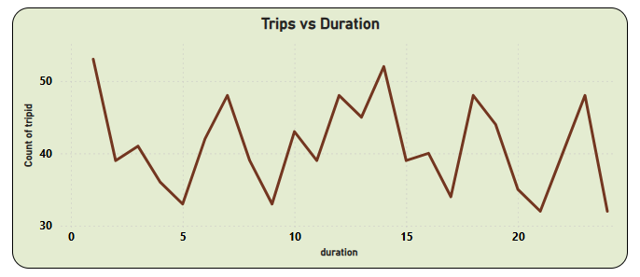
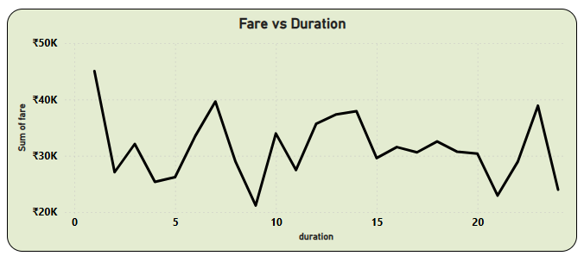
Exploratory Data Analysis: Ride Demand
Analyzing Ride Demand Over Time.
Identified peak demand periods: 8-10 AM and 5-8 PM.
Lower demand during early morning and late-night hours.
Summary of tables: Trips, Trip Details, Assembly, Duration, Payment

Slide 7
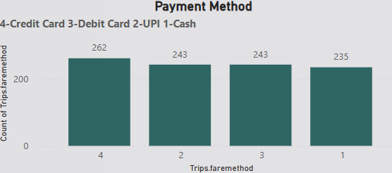
Payment Method Analysis
Credit card is the most frequently used payment method
All payment methods are used almost equally. .

Slide 8
Trip Trends Across Zones
Mahadevapura and Bommanahalli: heavy usage during morning hours.
Bangalore South: steady ride pattern throughout the day.
Ramanagaram: peaks in the night.

Slide 9
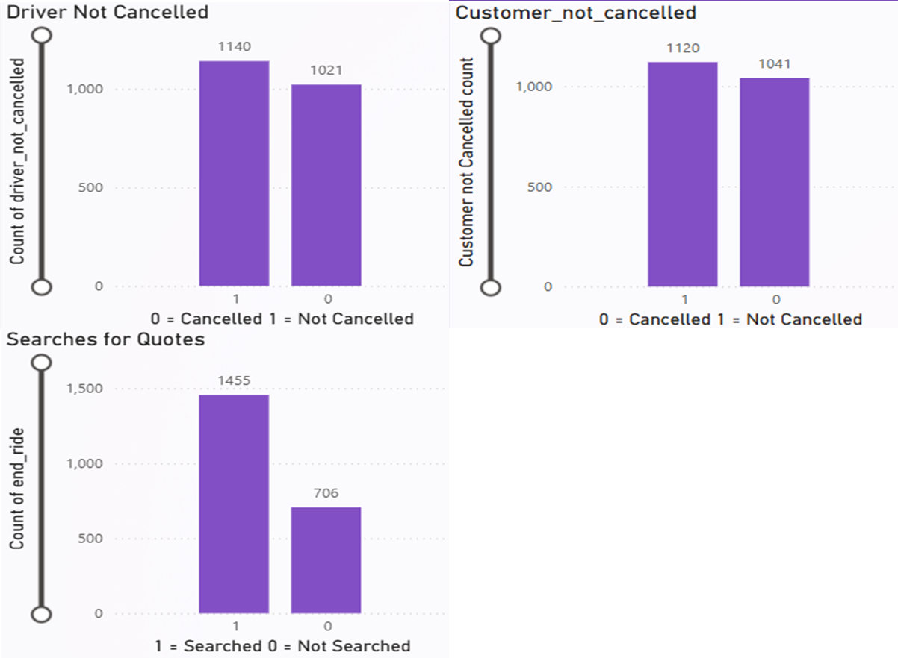
Namma Yatri Dashboard using Power BI

Slide 10
Analysis of Cancellations and Successful Rides
Drivers and customers have nearly a 50-50 split between cancellations and completions.
Completed trips are more than twice for users who searched for quotes.

Slide 11
Strategic Recommendations
Promote the quote search feature.
Incentivize completion and improve communication.
Implement cancellation reason tracking and penalties.
Focus on high-cancellation locations and predictive alerts.

